Slide 1
Rafsan Saadi
San Francisco State Universion
CS Senior presentation
11/13/2017

Slide 2
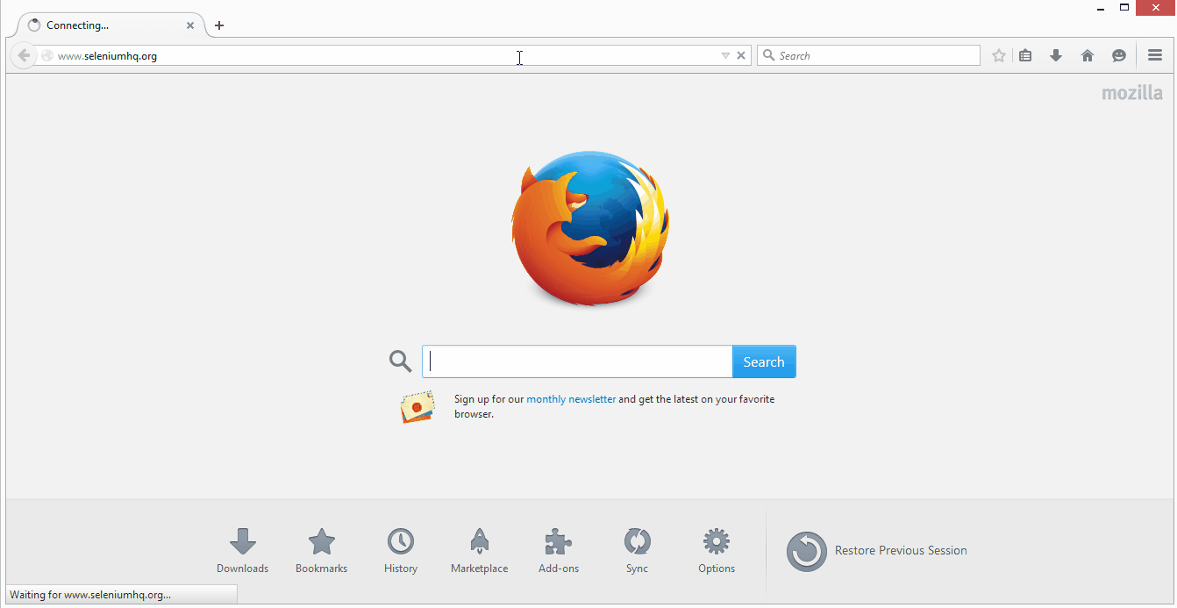
GUI Automation with Selenium

Slide 3
WHAT is Test Automation ?
A special software to automate repetitive but necessary testing tasks.
Control the execution of tests in reliable fashion and produce consistent result.
Perform testing that would be difficult to do manually.
A critical part of CI process.

Slide 4
WHY Automation Testing?
Automated Software Testing Saves Time and Money.
Vastly Increases Test Coverage.
Testing Improves Accuracy.
Automation Does What Manual Testing Cannot.

Slide 5
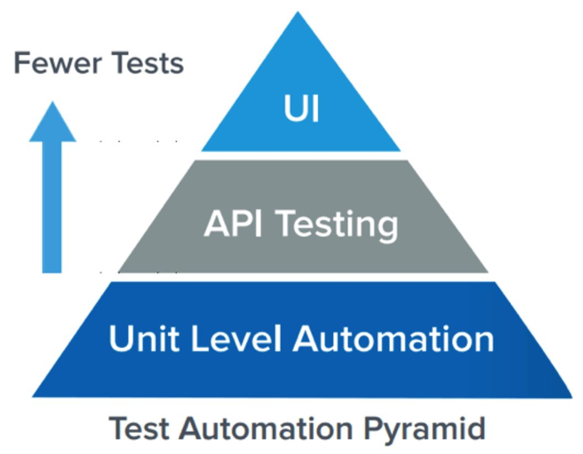
Test Automation Pyramid
Unit Test represents the base and biggest percentage of the test automation pyramid.
Automated API or Service Layer testing.
GUI Automation tests sit at the top of the pyramid and generally has the fewer number of tests.

Slide 6
GUI Automation with Selenium Framework
Java
Programming language for the Framework
https://docs.oracle.com/javase/tutorial/
Selenium WebDriver
Frontend automation tool
http://www.seleniumhq.org/
Apache Maven
Build automation tool used primarily for Java projects
https://maven.apache.org/
TestNG
Testing framework inspired from JUnit that is more powerful and easier to use
http://testng.org/
Log4j
Apache Log4j is a Java-based logging utility
https://logging.apache.org/log4j/2.x/

Slide 7
Sample Test Definition
Test Name: Verify buyer can contact media seller.
// ==== CONFIGURATION ====
// The item will be searched “Banana Gun”
// The message will be sent “Test Msg from Buyer on 11/07/2017”
// ==== ACTION ====
// Navigate to user LOGIN page
// Login as the BUYER
// Navigate to the App HOME page
// Searched for the item that was specified at the top: "Banana Gun“
// Send message to the seller with specified message body at the top
// ==== VERIFICATION ====
// Verify the message is sent successfully “Message Send Success”

Slide 8
Sample Test Implementation
Test Name: Verify buyer can contact media seller.
@Test(enabled = true, description = "Verify buyer can contact media seller") public void testBuyerContactMediaOwnerSuccess() throws Exception{
// ==== CONFIGURATION ====
// The item will be searched
String mediaTitle = "Banana Gun";
// The message will be sent
String messageToSeller = "Test Msg from Buyer on " + GeneralUtils.currentTimeStamp();

Slide 9
Sample Test Implementation (Cont…)
// ==== ACTION ====
// Navigate to user LOGIN page
UiActions.openUrl(USER_LOGIN_URL);
// Login as the BUYER
UiActions.loggingInAs(BUYER_USER_NAME,BUYER_USER_PASSWORD );
// Navigate to the App HOME page
UiActions.openingHomePage();
// Searched for the item that was specified at the top: "Banana Gun“
UiActions.searchWithoutCategory(mediaTitle);
// Send message to the seller with specified message body at the top
UiActions.sendMessageToSellerForSearchedItem(messageToSeller);

Slide 10
Sample Test Implementation (Cont…)
// ==== VERIFICATION ====
// Verify the message is sent successfully
UiVerifications.verifyMessageSentSuccessfully();

Slide 11
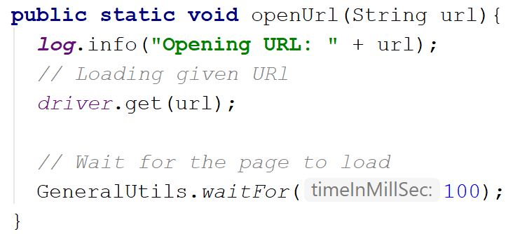
Method Implementation Details
UiActions.openUrl(USER_LOGIN_URL);

Slide 12
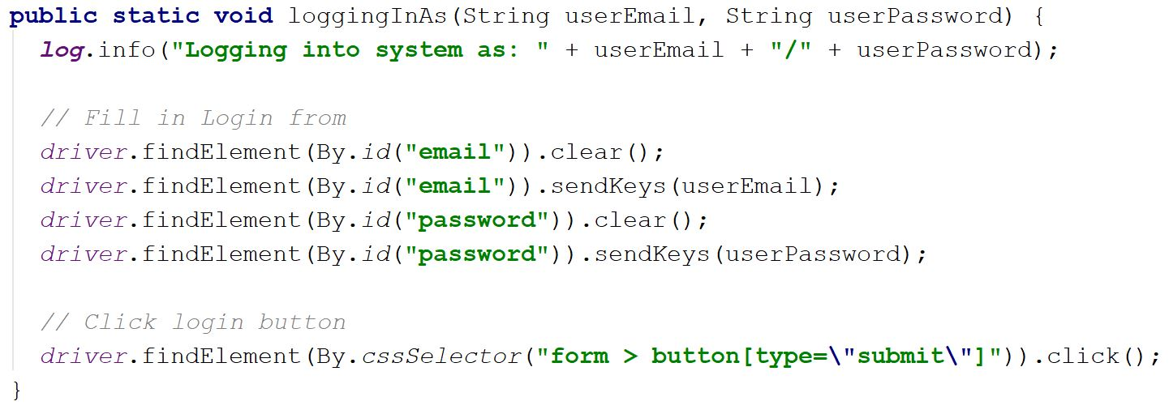
Method Implementation Details (Cont…)
UiActions.loggingInAs(BUYER_USER_NAME,BUYER_USER_PASSWORD );

Slide 13
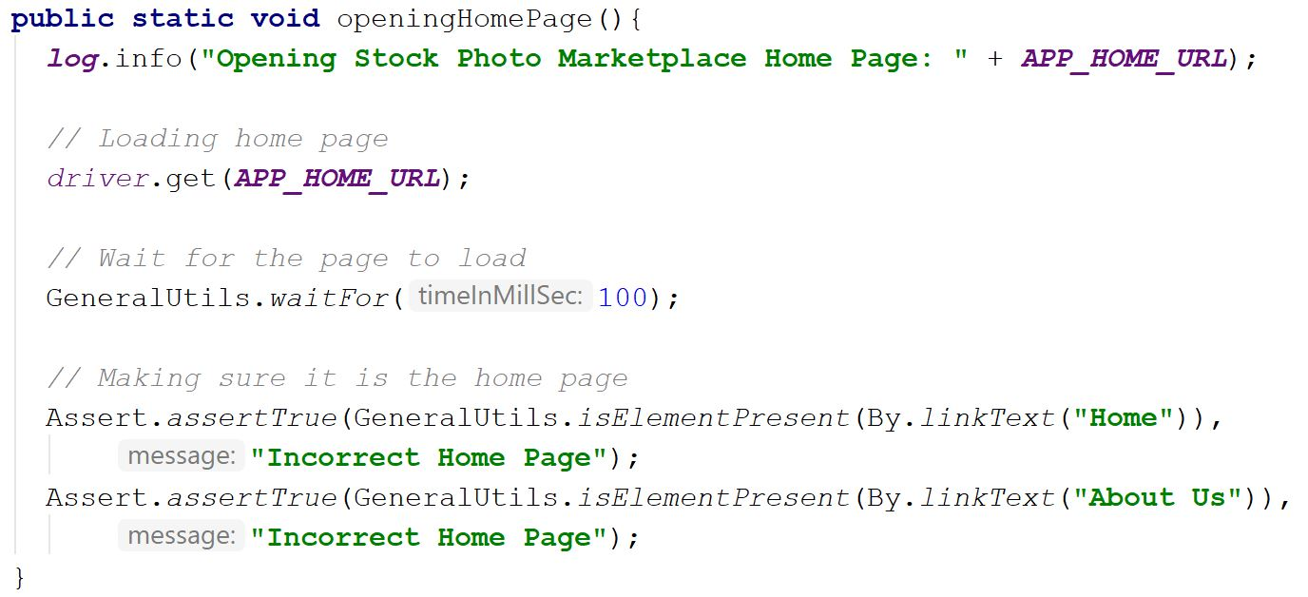
Method Implementation Details (Cont…)
UiActions.openingHomePage();

Slide 14
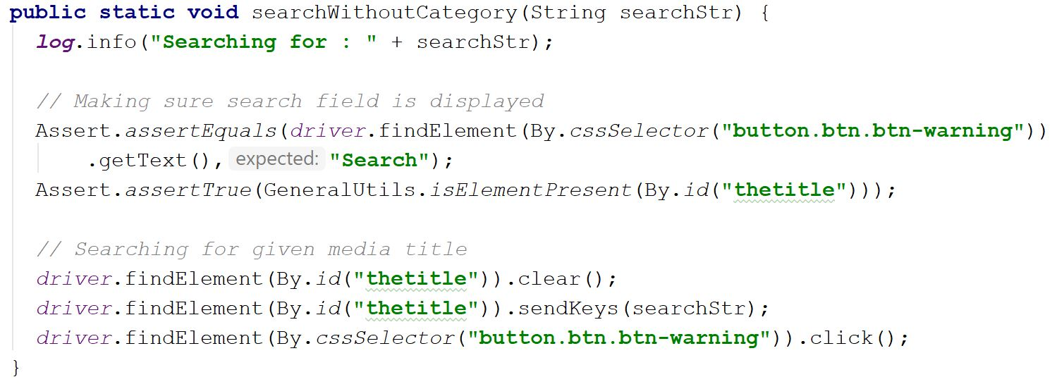
Method Implementation Details (Cont…)
UiActions.searchWithoutCategory(mediaTitle);

Slide 15
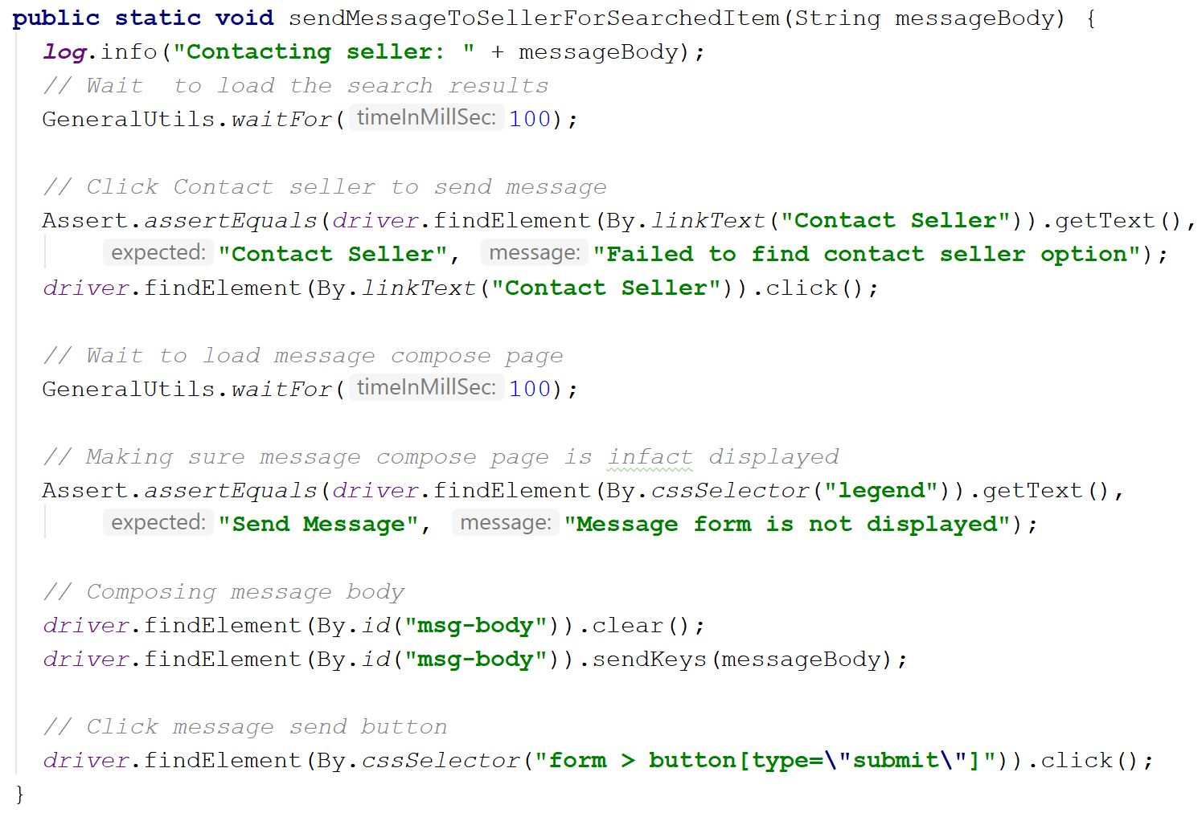
Method Implementation Details (Cont…)
UiActions.sendMessageToSellerForSearchedItem(messageToSeller);

Slide 16
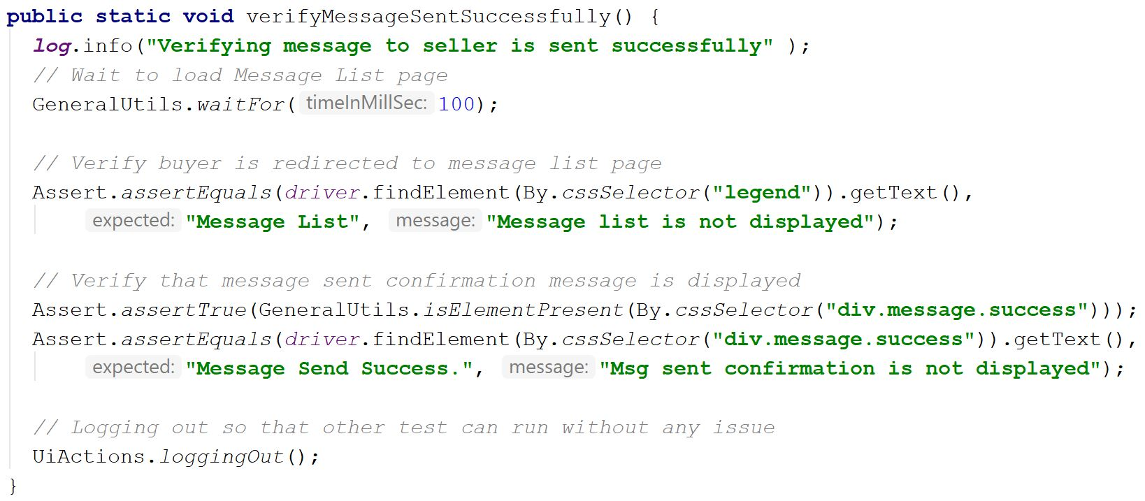
Method Implementation Details (Cont…)
UiVerifications.verifyMessageSentSuccessfully();

Slide 17
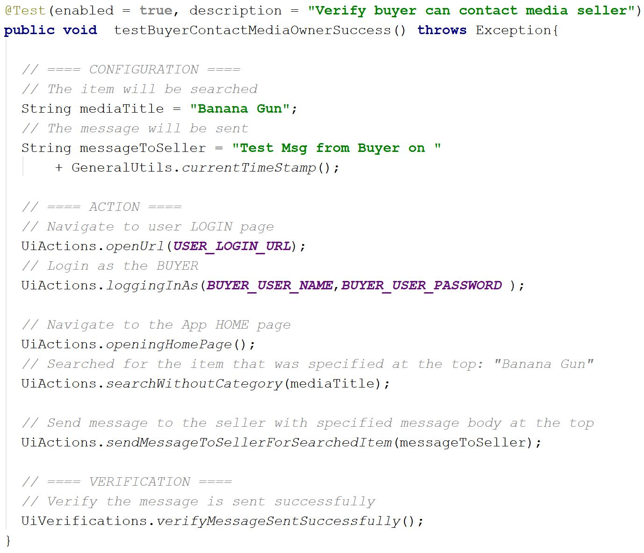
A Complete Test

Slide 18
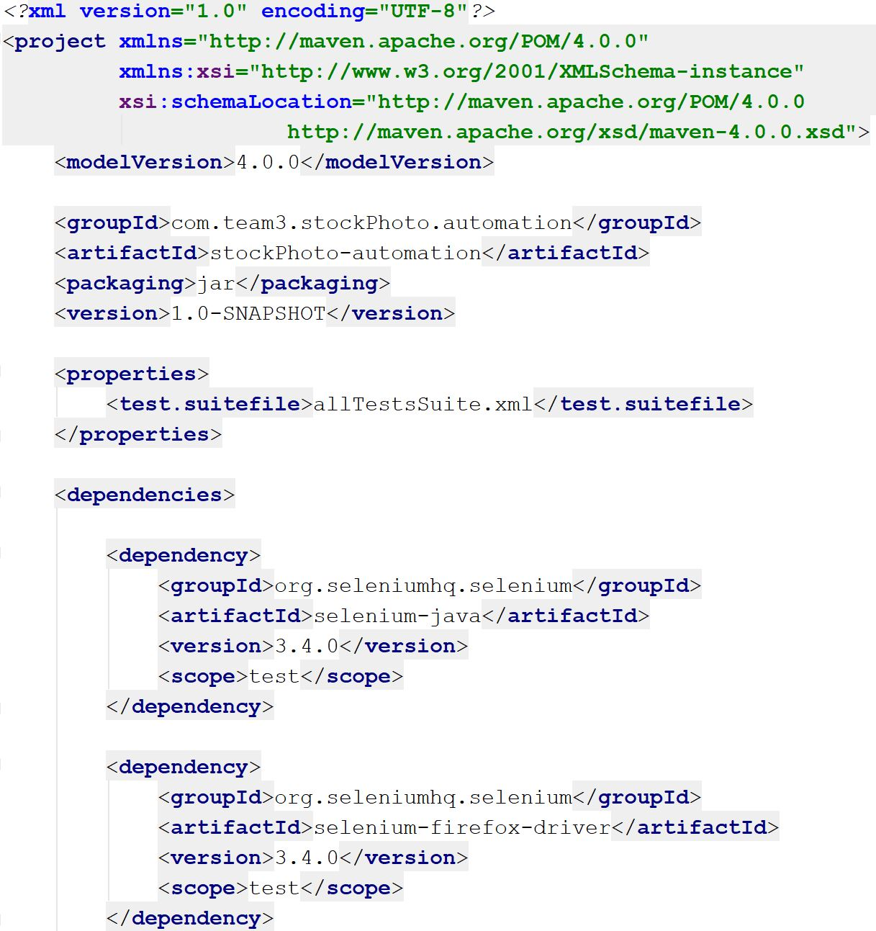
Sample Pom.xml File

Slide 19
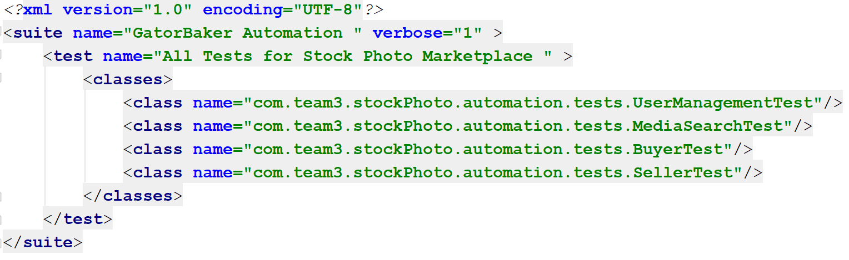
Sample TestsSuite.xml File

Slide 20
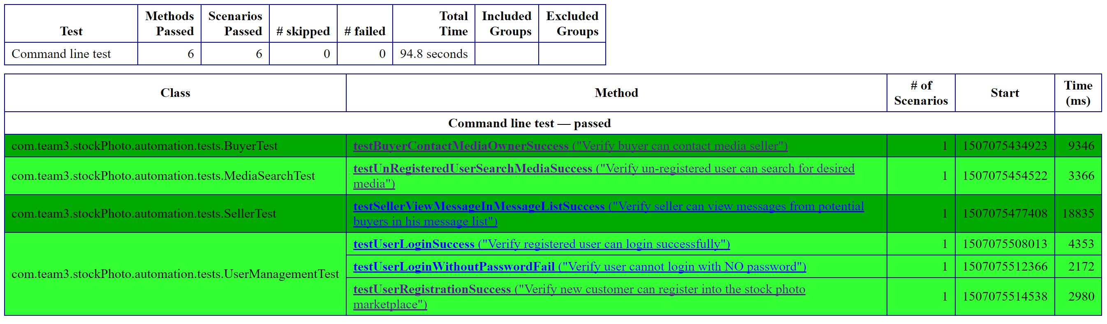
Sample Test Suite Execution Report
Above report is generated by the Selenium Surefire plugin

Slide 21
More Helpful Links
Selenium with Java (APIs)
https://seleniumhq.github.io/selenium/docs/api/java/index.html
Firebug
https://getfirebug.com/
Microsoft Best Practices for Coded UI Tests
https://docs.microsoft.com/en-us/visualstudio/test/best-practices-for-coded-ui-tests

Slide 22
Enjoy the Demo
Thank you !

